Slide 1


Slide 2
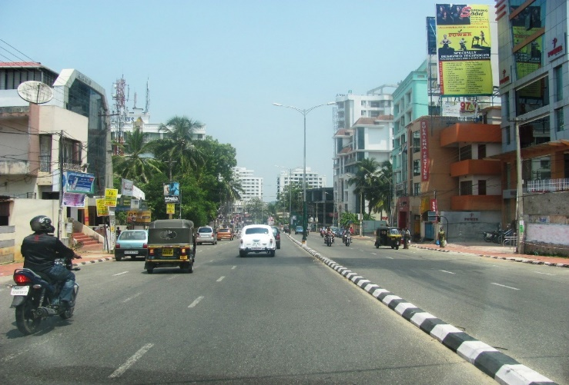
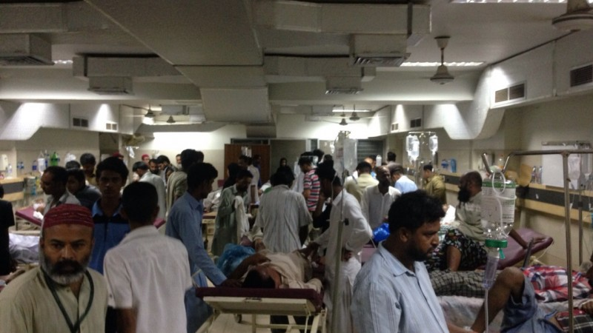
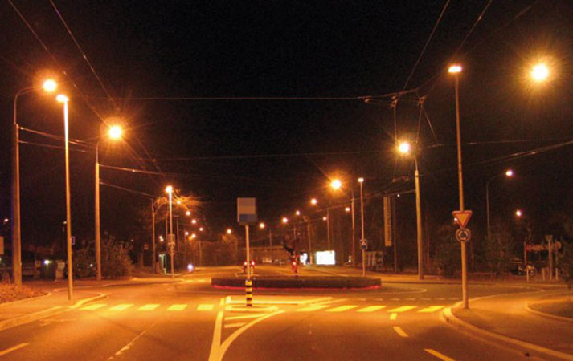


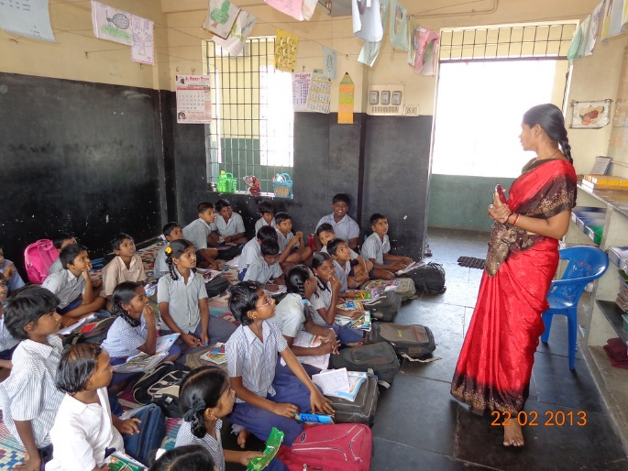
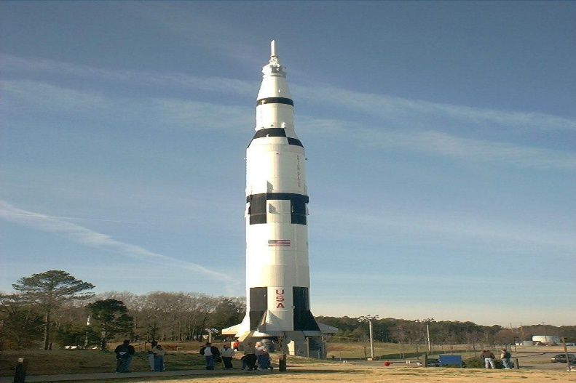

Slide 3
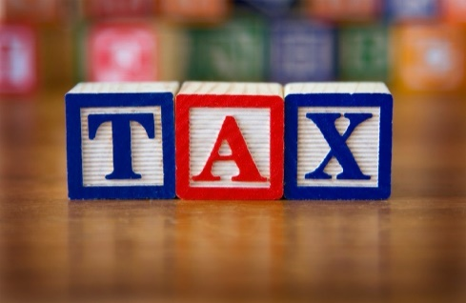
INTRODUCTION TO GST (GOODS & SERVICE TAX)
SO, WHERE DOES THE GOVERNMENT GET THIS MONEY?
FROM US !!!
IN THE FORM OF

Slide 4
INTRODUCTION TO GST (GOODS & SERVICE TAX)
WHAT IS TAX?
IT IS A SMALL CONTRIBUTION TOWARDS ALL THE ABOVE SAID THINGS WHICH DIRECTLY OR INDIRECTLY COME BACK TO US IN THE FORM OF VARIOUS SERVICES PROVIDED BY THE GOVERNMENT.

Slide 5

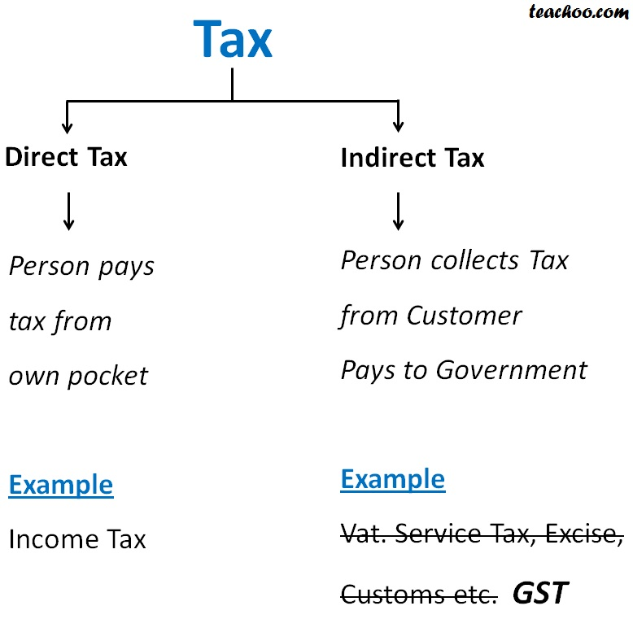
INTRODUCTION TO GST (GOODS & SERVICE TAX)

Slide 6
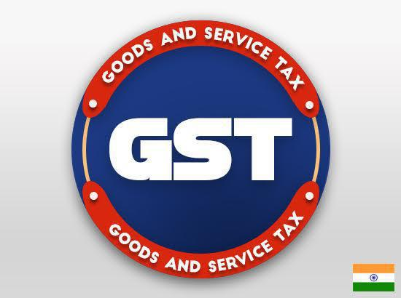
GST --- GOODS AND SERVICE TAX
ONE TAX
ONE NATION
ONE MARKET

Slide 7
INTRODUCTION TO GST (GOODS & SERVICE TAX)
HIGHLIGHTS
GST is not an incremental tax
Everybody has to submit their returns to government through online
Reduces price of manufacture goods
GST does not have any forms

Slide 8
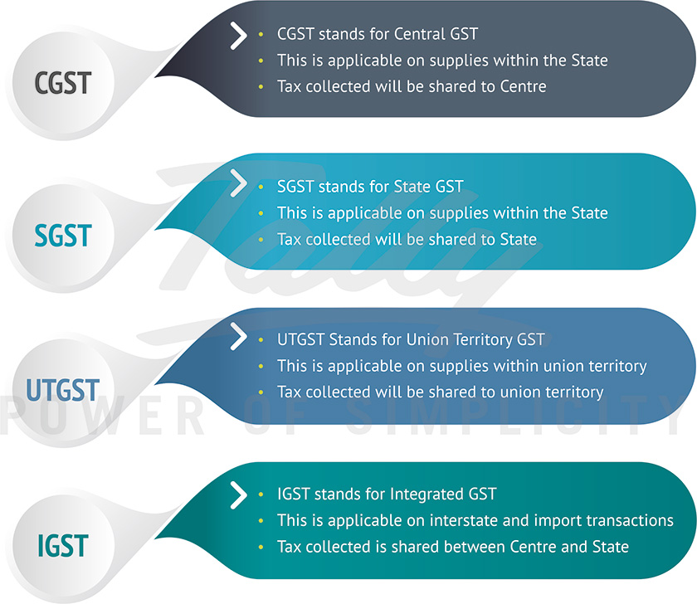
GST TAX STRUCTURE

Slide 9

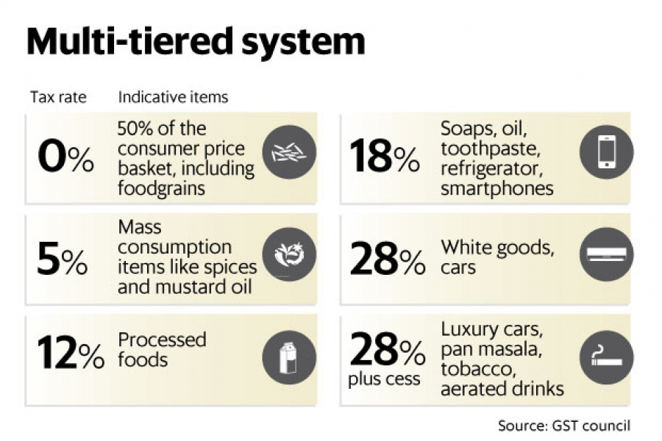
GST TAX RATES

Slide 10
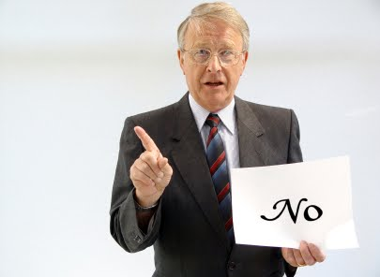
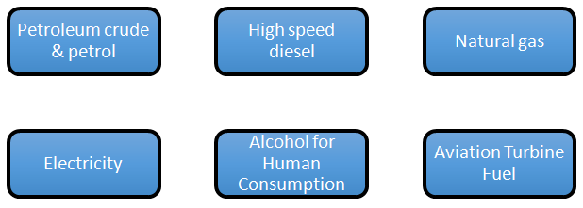
ITEMS NOT COVERED UNDER GST

Slide 11


